Slide 1

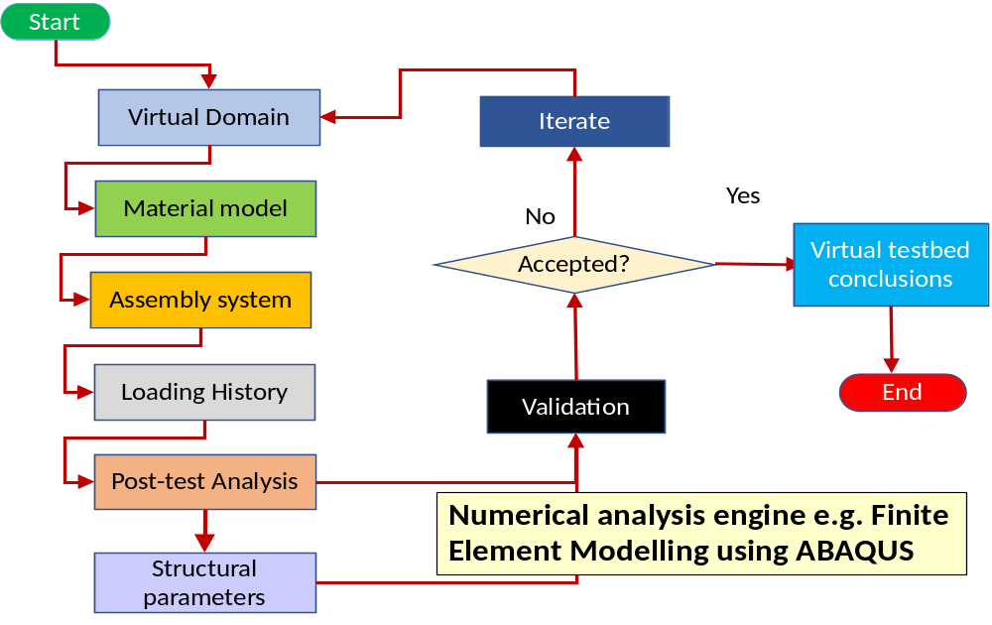
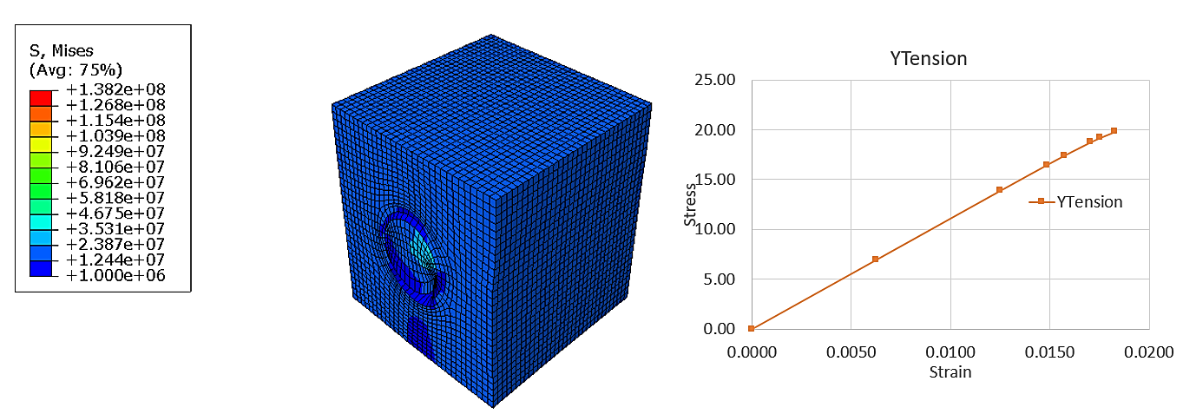
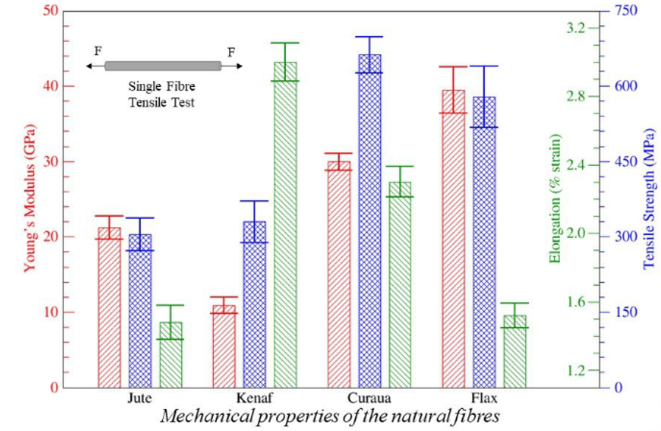
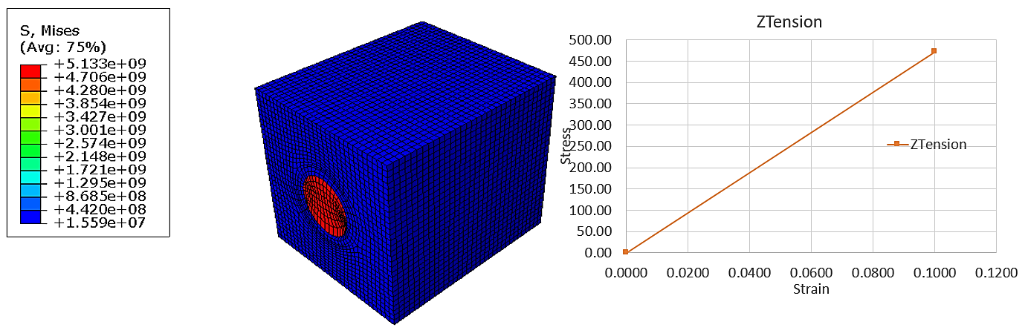
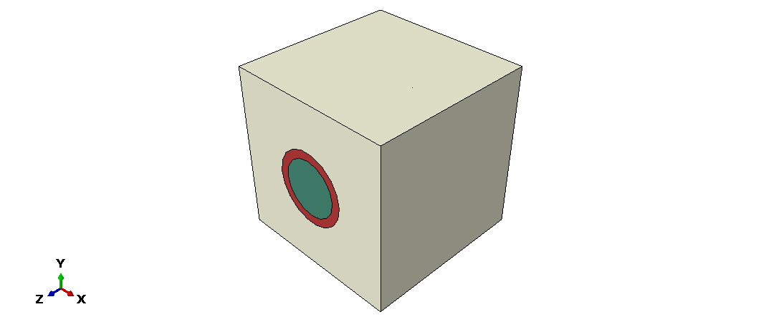
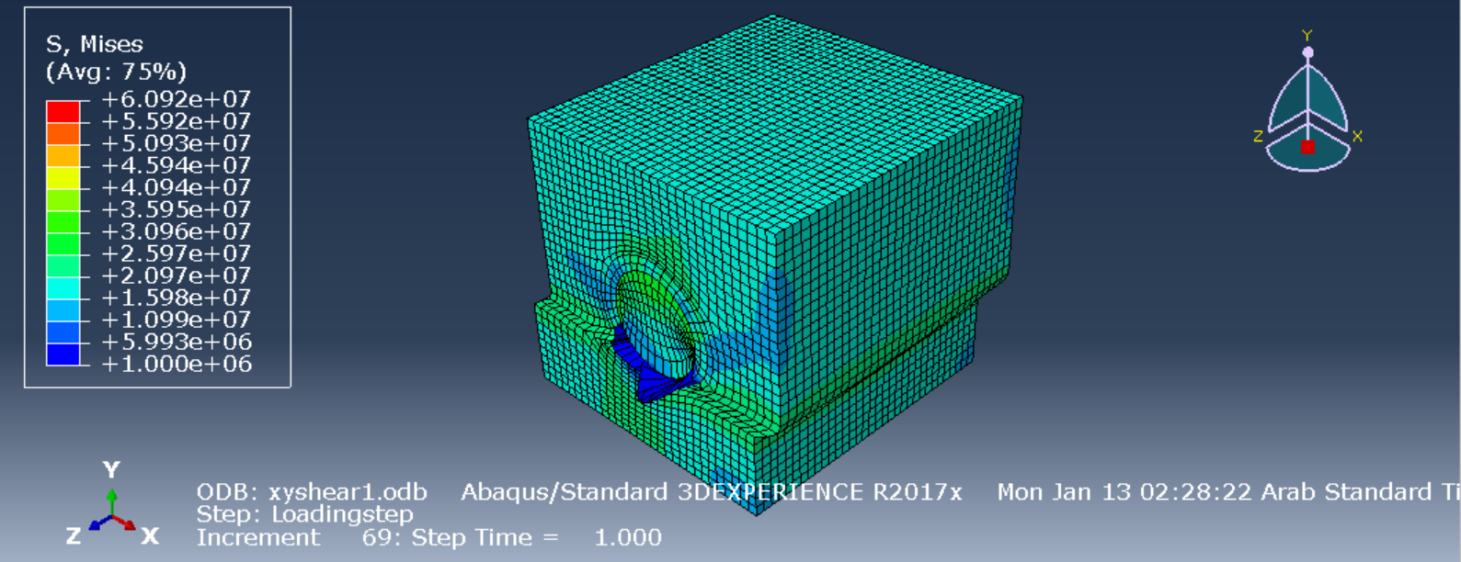
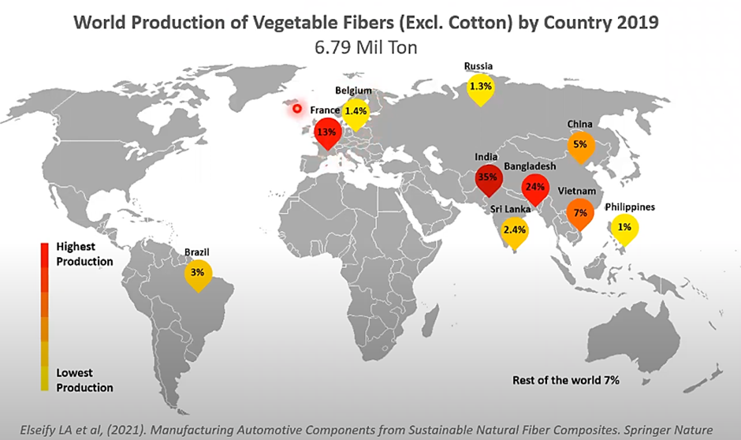
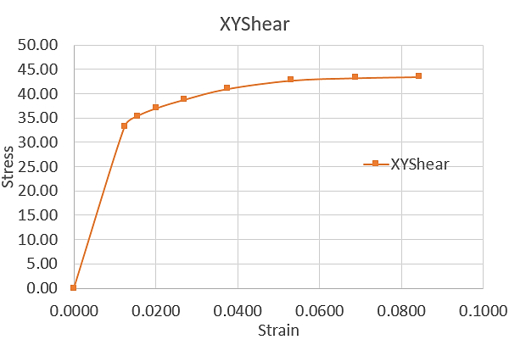
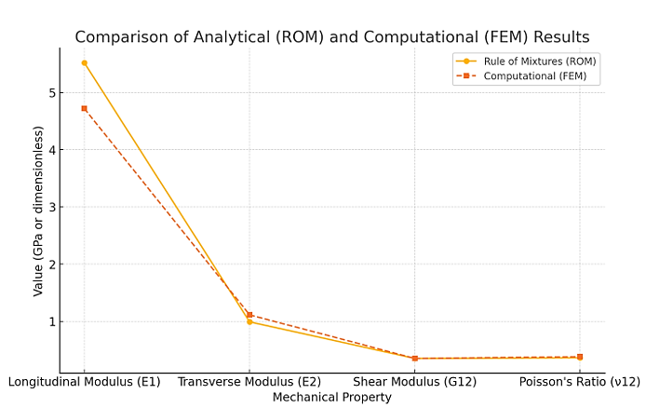
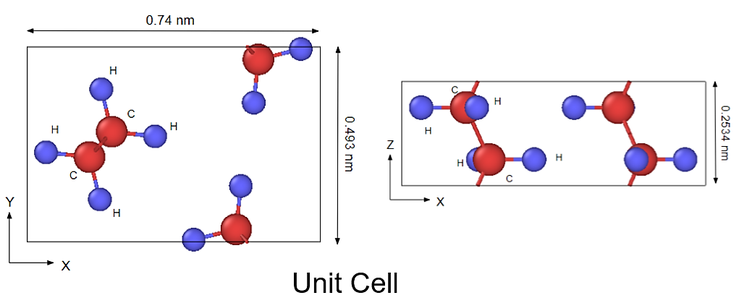
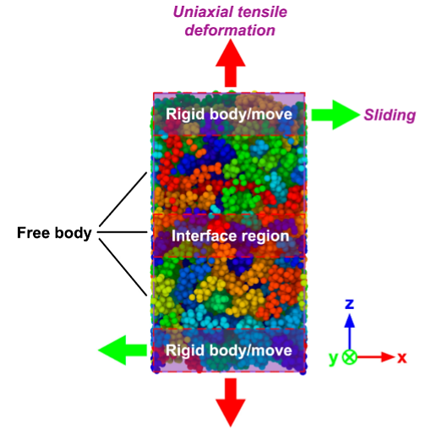

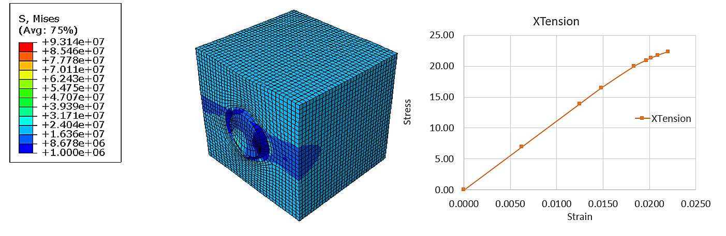
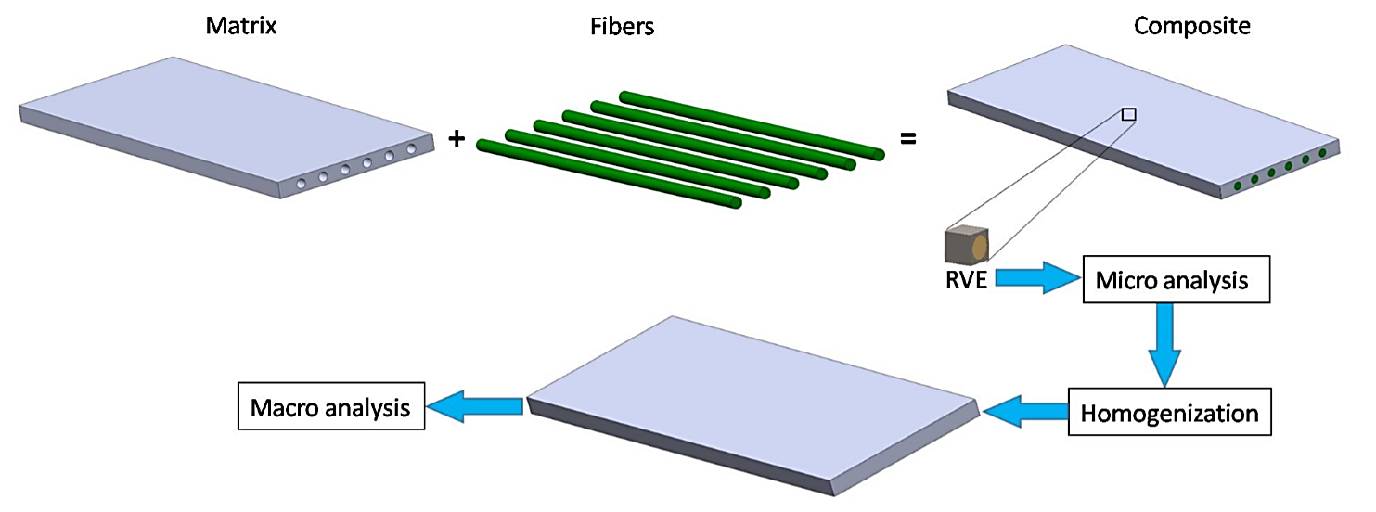
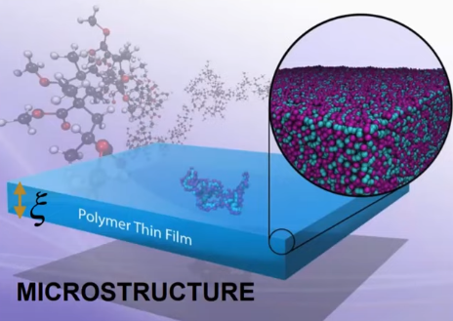
Multiscale Modeling & Characterization of Flax Reinforced High-Density Polyethylene (HDPE) Composites
Joash M. Oendo¹, Dr. Wael G.E. Abdelrahman², Dr. Suhail H. Vattathurvalappil³.
¹ Graduate student, Department of Aerospace Engineering, King Fahd University of Petroleum & Minerals (KFUPM), ²Associate Professor (KFUPM), ³Assistant Professor (KFUPM)
Introduction
Methodology
Results & Discussion (FEA)
Growing environmental concerns and increased waste management regulations have made the development of sustainable composites a current industrial necessity.
Flax reinforced (HDPE) composites are gaining attention as sustainable alternatives for structural applications due to their biodegradability and favorable mechanical properties.
Flax has promising mechanical properties among the (NFRCs).
Multiscale modeling approach; combines finite element analysis (FEA) and molecular dynamics (MD) simulations to analyze flax-HDPE composite.
The matrix carries most of the load (Y-tension).
The fiber is aligned with the loading direction, the composite exhibits its highest mechanical strength (Z-tension).
The stress distribution map demonstrates high stress concentration & failure predictions at the fiber-matrix interface (XY/XZ-shear).
The composite successfully was modeled, characterized & validated analytically.
Higher stiffness (4.719 GPa) and strength (471.93 MPa) in the fiber-aligned direction (Z), with weaker load-bearing in transverse directions (X & Y).
Fiber-matrix interactions strongly influence mechanical performance, emphasizing the need for better interfacial adhesion.
This work is supported by the Department of Aerospace Engineering, King Fahd University of Petroleum & Minerals (KFUPM), Dhahran, 31261, Saudi Arabia
https://www.researchgate.net/publication/353791032_Manufacturing_Automotive_Components_from_Sustainable_Natural_Fiber_Composites
https://iopscience.iop.org/article/10.1088/1742-6596/1240/1/012103
https://www.sciencedirect.com/science/article/pii/S223878542300162X?via%3Dihub
Micromechanical Modeling (FEA)
Achieved using representative volume element (RVE) to model unit cell of flax-HDPE composite.
Uniaxial loading in micromechanics analyzes stress distribution and mechanical response in flax-HDPE composites.
Figure 1: Natural fibers¹
Problem Statement
Interface
Limited research on flax-HDPE Composites: While flax fiber composites with other polymers have been studied, no prior research has focused on computational micromechanical modeling of flax-HDPE composites.
Interfacial challenges: Poor fiber-matrix bonding reduces load-bearing capacity, durability, and overall structural integrity of the composite.
Figure 2: World production of natural fibers²
NFRCs including flax fibers absorb moisture, low thermal resistance, & poor bond with polymers. This poor compatibility affects mechanical performance.
Fiber (Flax)
Matrix (HDPE)
Molecular Dynamics (MD) Modeling
An atomistic model of flax-HDPE interface composite will be modeled using Material Studio.
Higher negative interfacial energy indicates stronger adhesion.
Uniaxial tensile loading to study fiber-matrix interface and mechanical response.
Figure 4: Atomistic model³
Conclusions
Objectives
Develop a finite element model (FEA) to analyze the micromechanical behavior of flax-HDPE composites.
Investigate stress distribution and load transfer at the fiber-matrix interface using micromechanical modeling.
Examine interfacial adhesion, stress transfer, and failure mechanisms using molecular dynamics (MD) simulations.
Results & Discussion (FEA)
Highest stress concentration occurs at the fiber-matrix interface (X-tension).
Future Work
Develop molecular dynamics (MD) model: an atomistic model of the flax-HDPE composite interface for nanoscale analysis. Study interfacial adhesion: investigate fiber-matrix interactions, stress transfer, and debonding mechanisms under loading.
Acknowledgements
References
Figure 3: Atomic structure³

